Slide 1
DIGITAL PORTFOLIO
STUDENT NAME: NASIYA
REGISTER NO: 34624U09061
NM ID: ASTVU346M24366
DEPARTMENT: BCA
COLLEGE: MMES WOMEN’S ART’S AND SCIENCE COLLEGE, THIRUVALLUVAR UNIVERSITY

Slide 2
E-IDENTITY
MY DIGITAL PORTFOLIO

Slide 3
AGENDA
Problem statement
Project overview
End users
Tools and techniques
Application design and layout
Features and functionality
Results and screenshots
Conclusion
GitHub link

Slide 4
PROBLEM STATEMENT
People face difficulty in managing multiple IDs (like Aadhar, Passport, Driving License). Manual verification is slow and prone to errors. No single digital platform to securely store and verify identity information.

Slide 5
PROJECT OVERVIEW
Create a web-based system where users can store, manage, and share their digital identity. Provides a simple interface to add personal details and documents. Fast and secure verification using the web application.

Slide 6
End users
Individuals who need to store identity documents digitally. Government agencies or service providers needing fast identity verification. Educational institutions for student verification.

Slide 7
Tools and technologies
HTML – For webpage structure.
CSS – For styling the user interface (clean and simple design). JavaScript – For interactivity (form validation, data storage, etc.).

Slide 8
Portfolio design and layout
Simple navigation bar with sections: Home, Add Identity, View Identity, About. Clean form design for adding identity details (Name, Date of Birth, ID Numbers, Upload Documents). Display stored identity in a readable card format. Responsive design (works on mobile and desktop).

Slide 9
Features and functionality
Add Identity Details: Simple form to input personal details and upload scanned documents. View Identity: Display stored identity details in a user-friendly way. Edit or Delete Identity: Allow users to update or remove existing identity information. Search Functionality: Find stored identities by name or ID number. Data Stored Locally: Uses browser localStorage (no backend needed for simple projects). Interactive Buttons: Save, View, Delete, and Edit with JavaScript functions.

Slide 10
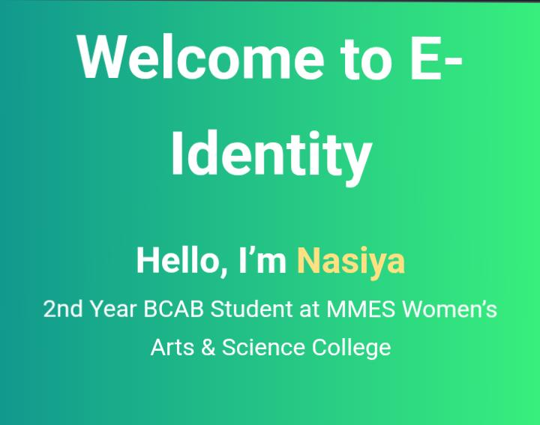
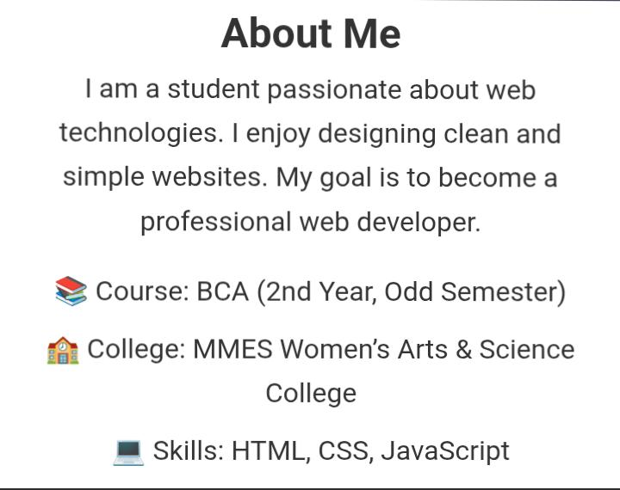
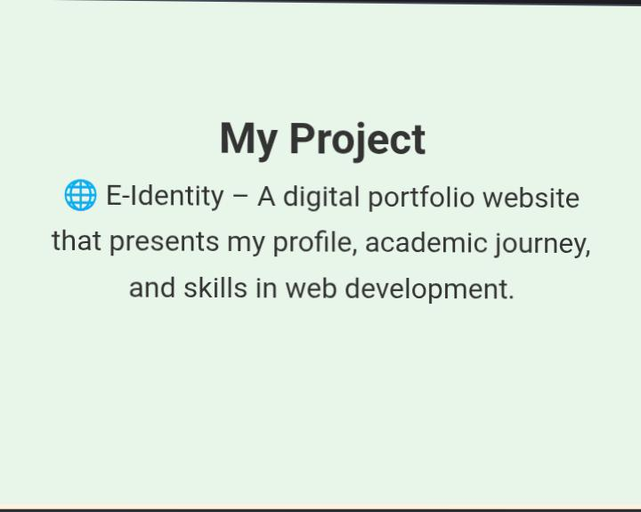
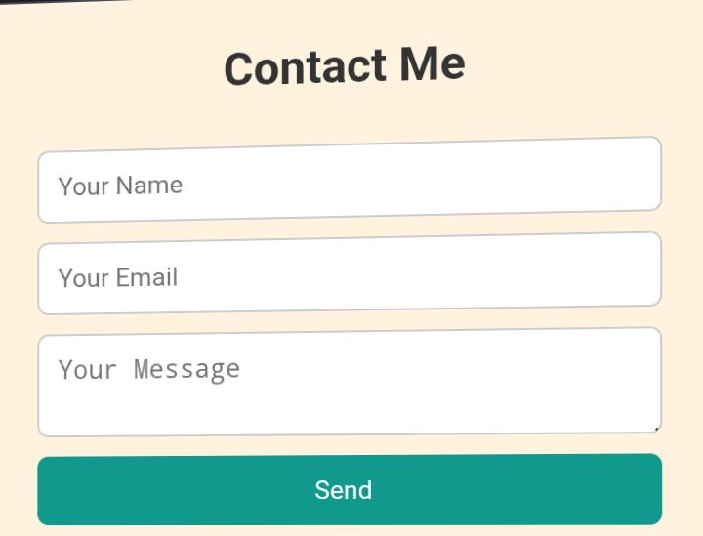
Results and screenshots

Slide 11
Conclusion
E- identity system simplifies managing multiple identity document
Provides a secure and easy way to store and retrieve identity details.
Useful for individuals and organizations needing fast identity access.
Bulilt using HTML,CSS, and JavaScript easy to maintain and extend in the future.

Slide 12
GitHub link
https://nasiya-star.github.io/My-digital-portfolio-/
Thank you…🤍

